Slide 1

Eigen value and Eigen vectors
ML LABS PVT LTD || WWW.ANALYTICS6.COM || DATA SCIENCE , AI , ML ,COMPUTER VISION || TRAINING AND CONSULTING
Phone Number : 91-6362546088 || Email : contact@analytics6.com

Slide 2

Introduction to Eigenvalues and Eigenvector
Let A be an n×n matrix.
A scalar λ is called an eigenvalue of A if the equation Ax=λx has a nonzero solution x. Such a nonzero solution x is called an eigenvector corresponding to the eigenvalue λ.
ML LABS PVT LTD || WWW.ANALYTICS6.COM || DATA SCIENCE , AI , ML ,COMPUTER VISION || TRAINING AND CONSULTING
Phone Number : 91-6362546088 || Email : contact@analytics6.com

Slide 3
Introduction to Eigenvector
In linear algebra, an eigenvector or characteristic vector of a square matrix is a vector that does not changes its direction under the associated linear transformation.
If V is a vector that is not zero, than it is an eigenvector of a square matrix A if Ax is a scalar multiple of x. This condition should be written as the equation:
Ax= λx.
A= Matrix
X= Eigenvector
λ = Eigenvalue
ML LABS PVT LTD || WWW.ANALYTICS6.COM || DATA SCIENCE , AI , ML ,COMPUTER VISION || TRAINING AND CONSULTING
Phone Number : 91-6362546088 || Email : contact@analytics6.com

Slide 4
Introduction to Eigen value
In above equation λ is a scalar known as the eigenvalue or characteristic value associated with eigenvector x.
We can find the eigenvalues by determining the roots of the characteristic equation
|A-λ·I|=0
ML LABS PVT LTD || WWW.ANALYTICS6.COM || DATA SCIENCE , AI , ML ,COMPUTER VISION || TRAINING AND CONSULTING
Phone Number : 91-6362546088 || Email : contact@analytics6.com

Slide 5
Difference between eigenvalues and eigenvectors
Eigenvectors are used for understanding linear transformations. In data analysis, we usually calculate the eigenvectors for a correlation or covariance matrix. Eigenvectors are the directions along which a particular linear transformation acts by flipping, compressing or stretching.
ML LABS PVT LTD || WWW.ANALYTICS6.COM || DATA SCIENCE , AI , ML ,COMPUTER VISION || TRAINING AND CONSULTING
Phone Number : 91-6362546088 || Email : contact@analytics6.com

Slide 6
Difference between eigenvalues and eigenvectors
Eigenvalue can be referred to as the strength of the transformation in the direction of eigenvector or the factor by which the compression occurs.
ML LABS PVT LTD || WWW.ANALYTICS6.COM || DATA SCIENCE , AI , ML ,COMPUTER VISION || TRAINING AND CONSULTING
Phone Number : 91-6362546088 || Email : contact@analytics6.com

Slide 7
Properties of eigenvalues and eigenvectors
The sum of the eigenvalues of a matrix equals the trace of the matrix.
A matrix is singular if and only if it has a zero eigen value.
The eigenvalues of an upper or lower triangular matrix are the element on the main diagonal.
If λ is an eigenvalue of A then K is an eigenvalue of KA where Kλ is any arbitrary scalar.
ML LABS PVT LTD || WWW.ANALYTICS6.COM || DATA SCIENCE , AI , ML ,COMPUTER VISION || TRAINING AND CONSULTING
Phone Number : 91-6362546088 || Email : contact@analytics6.com

Slide 8
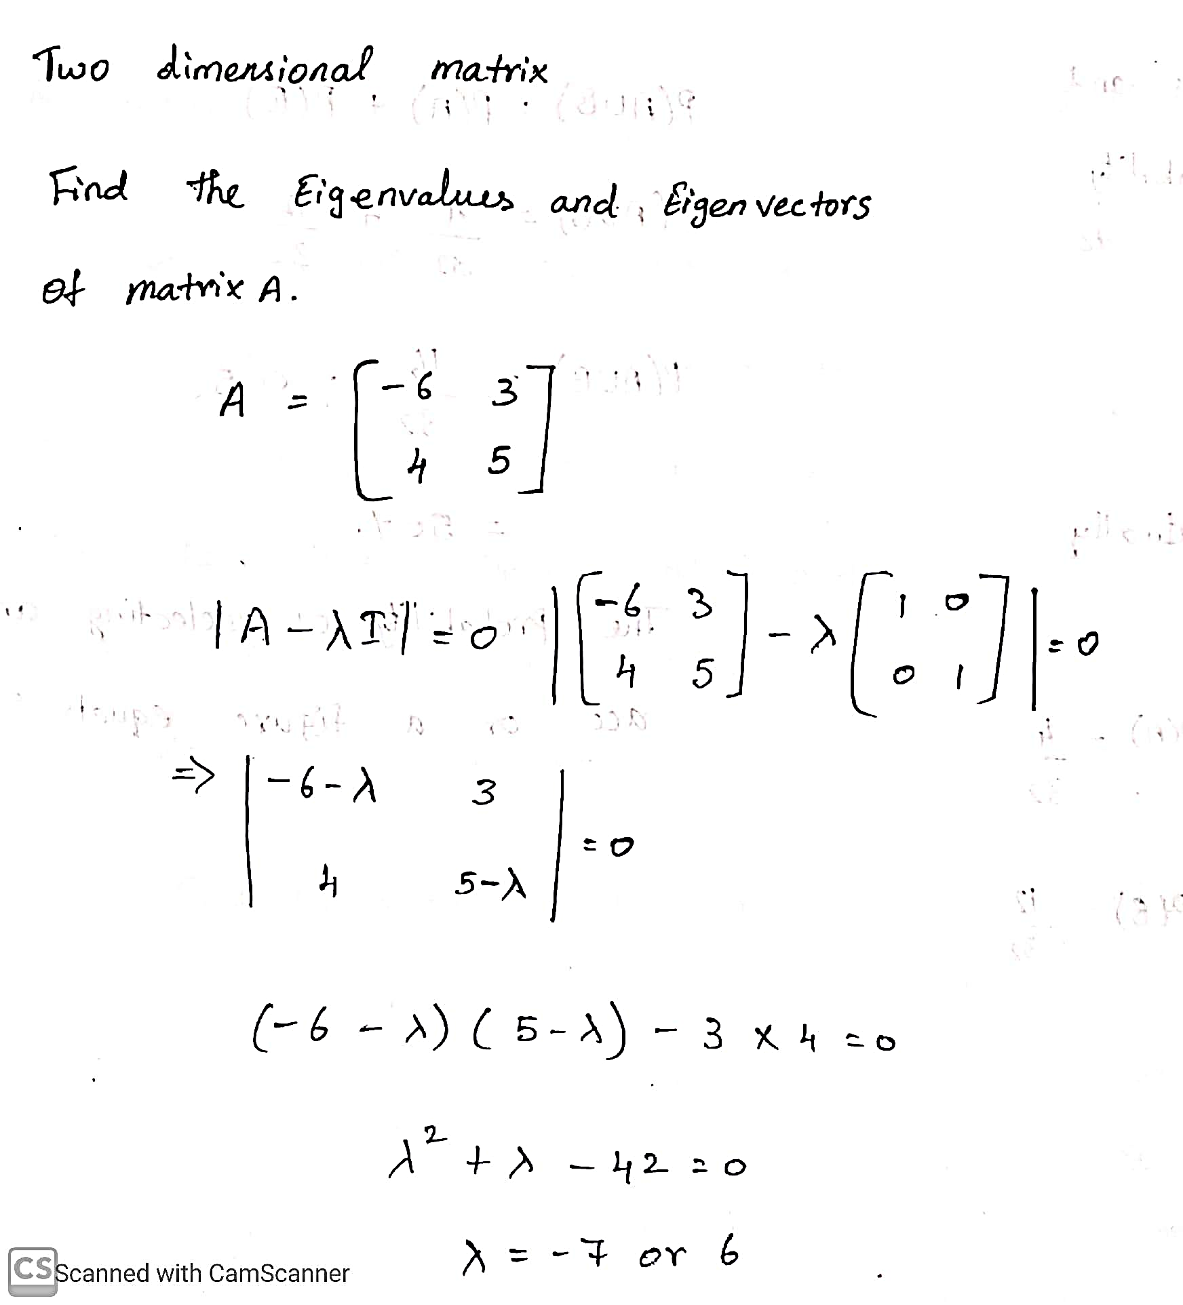
Two Dimensional Matrix
ML LABS PVT LTD || WWW.ANALYTICS6.COM || DATA SCIENCE , AI , ML ,COMPUTER VISION || TRAINING AND CONSULTING
Phone Number : 91-6362546088 || Email : contact@analytics6.com

Slide 9
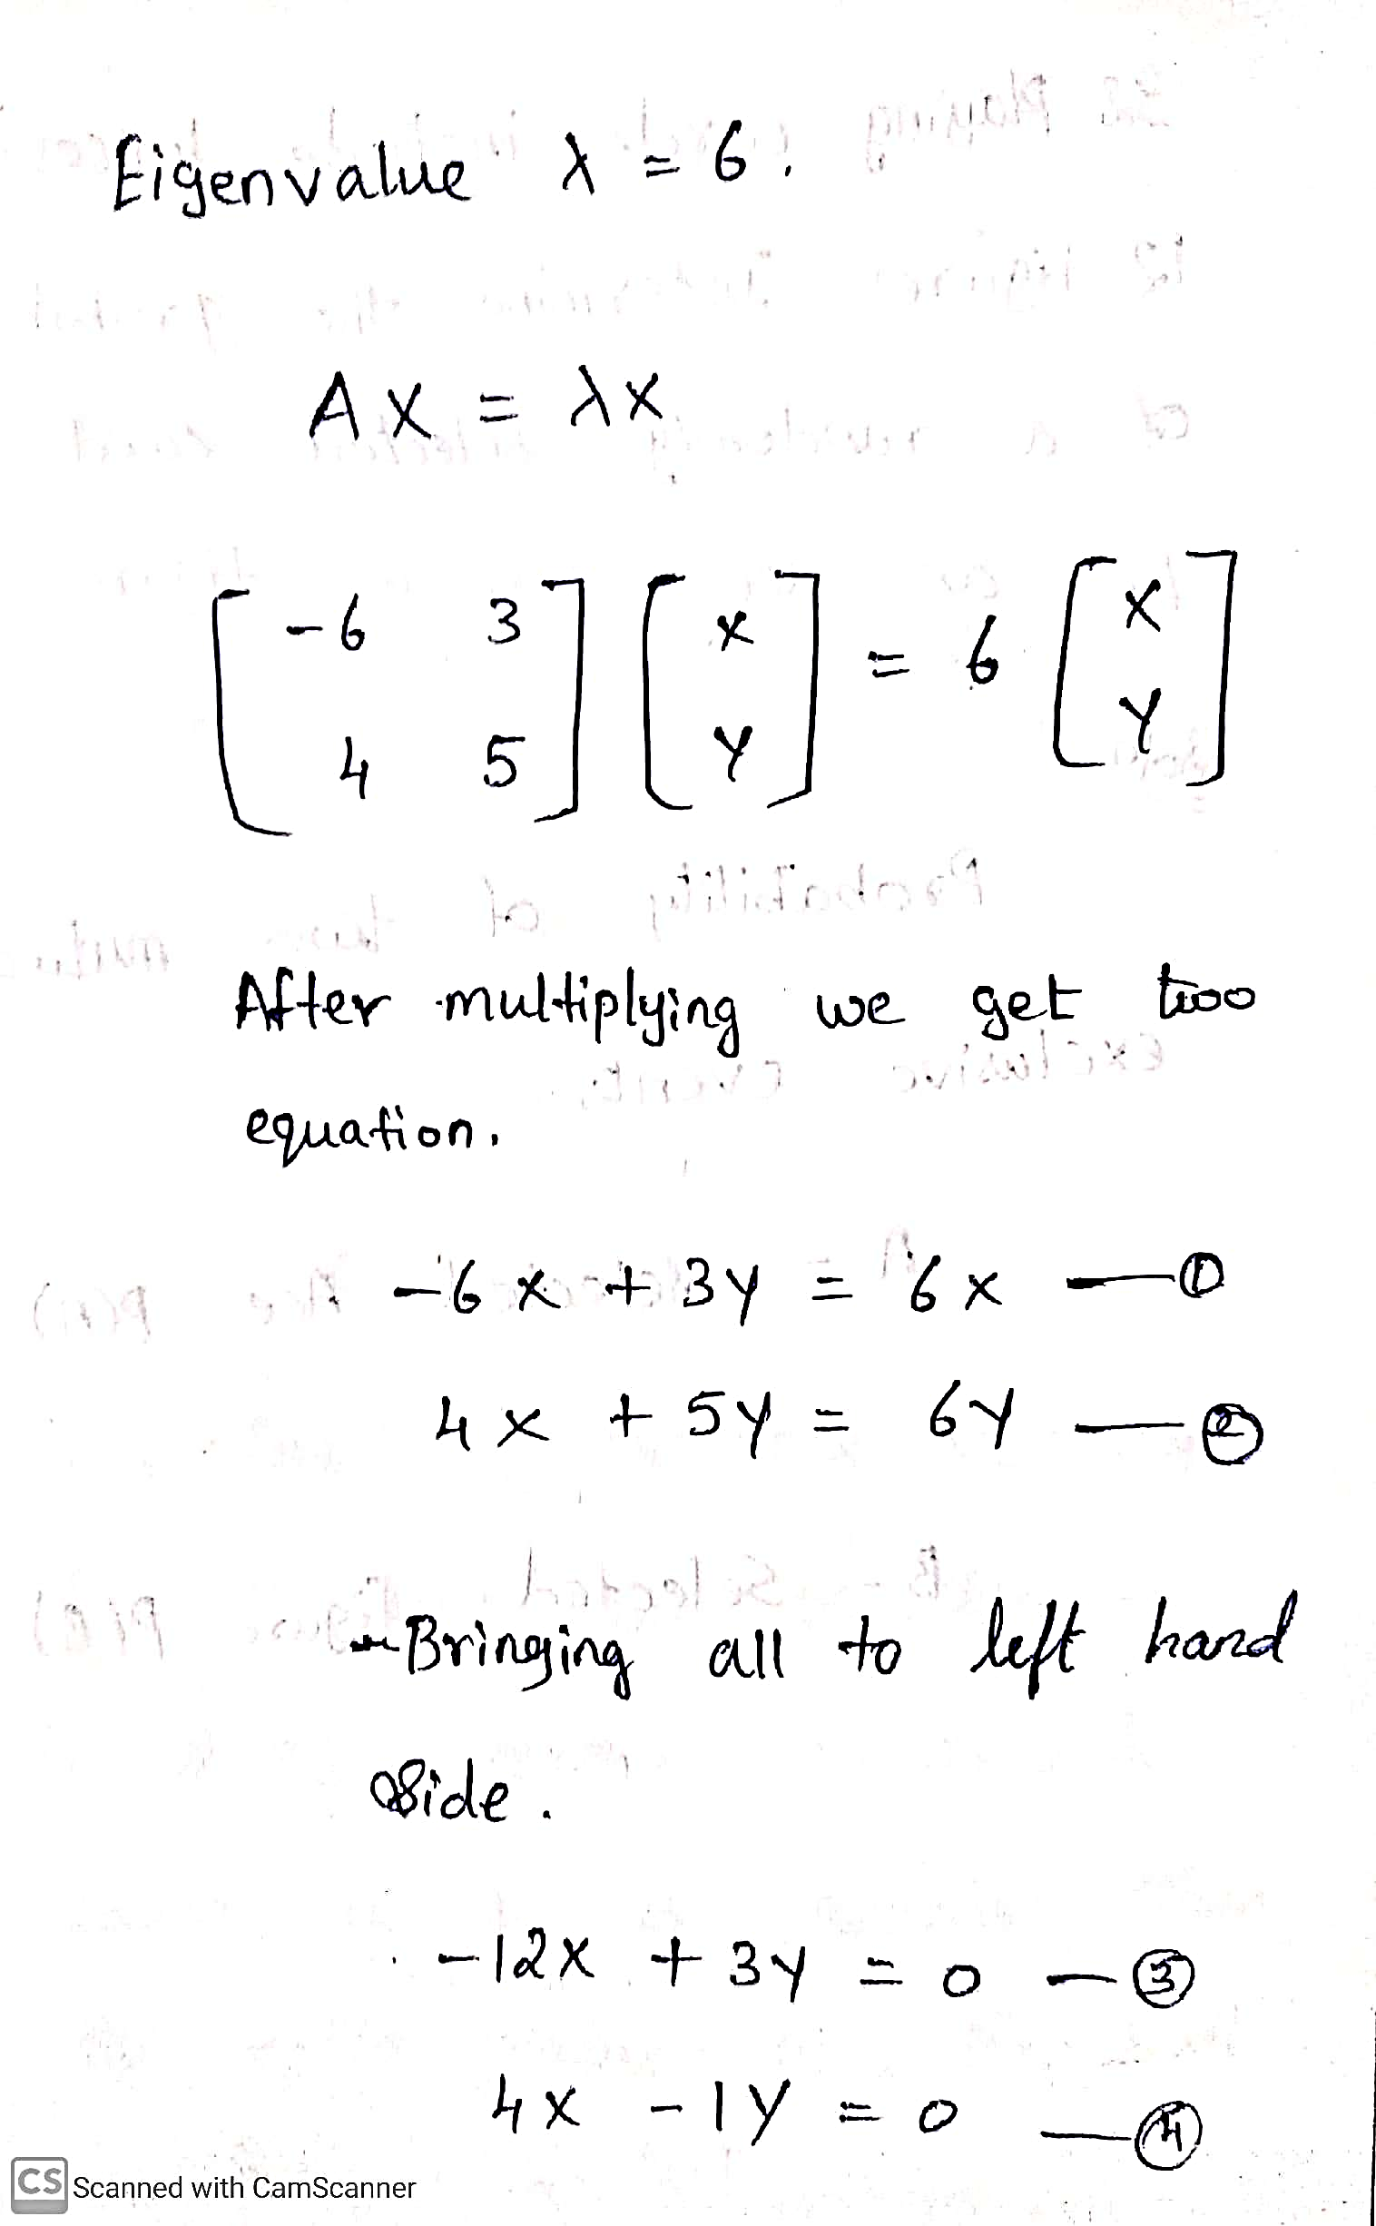
Two Dimensional Matrix
ML LABS PVT LTD || WWW.ANALYTICS6.COM || DATA SCIENCE , AI , ML ,COMPUTER VISION || TRAINING AND CONSULTING
Phone Number : 91-6362546088 || Email : contact@analytics6.com

Slide 10
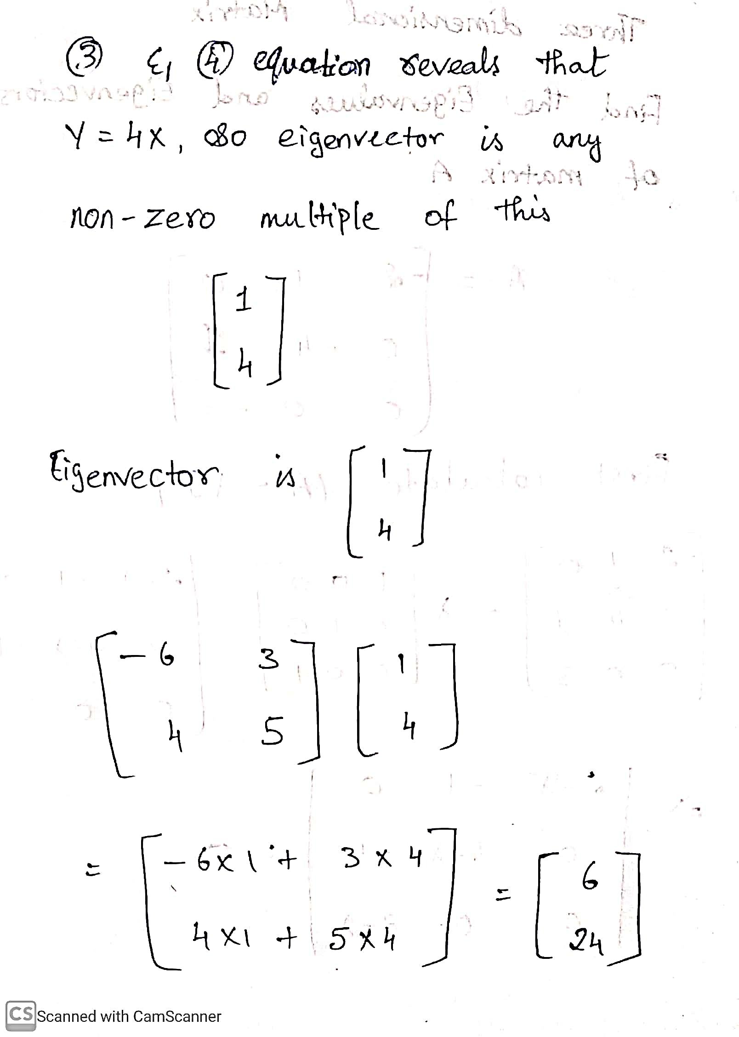
Two Dimensional Matrix
ML LABS PVT LTD || WWW.ANALYTICS6.COM || DATA SCIENCE , AI , ML ,COMPUTER VISION || TRAINING AND CONSULTING
Phone Number : 91-6362546088 || Email : contact@analytics6.com

Slide 11
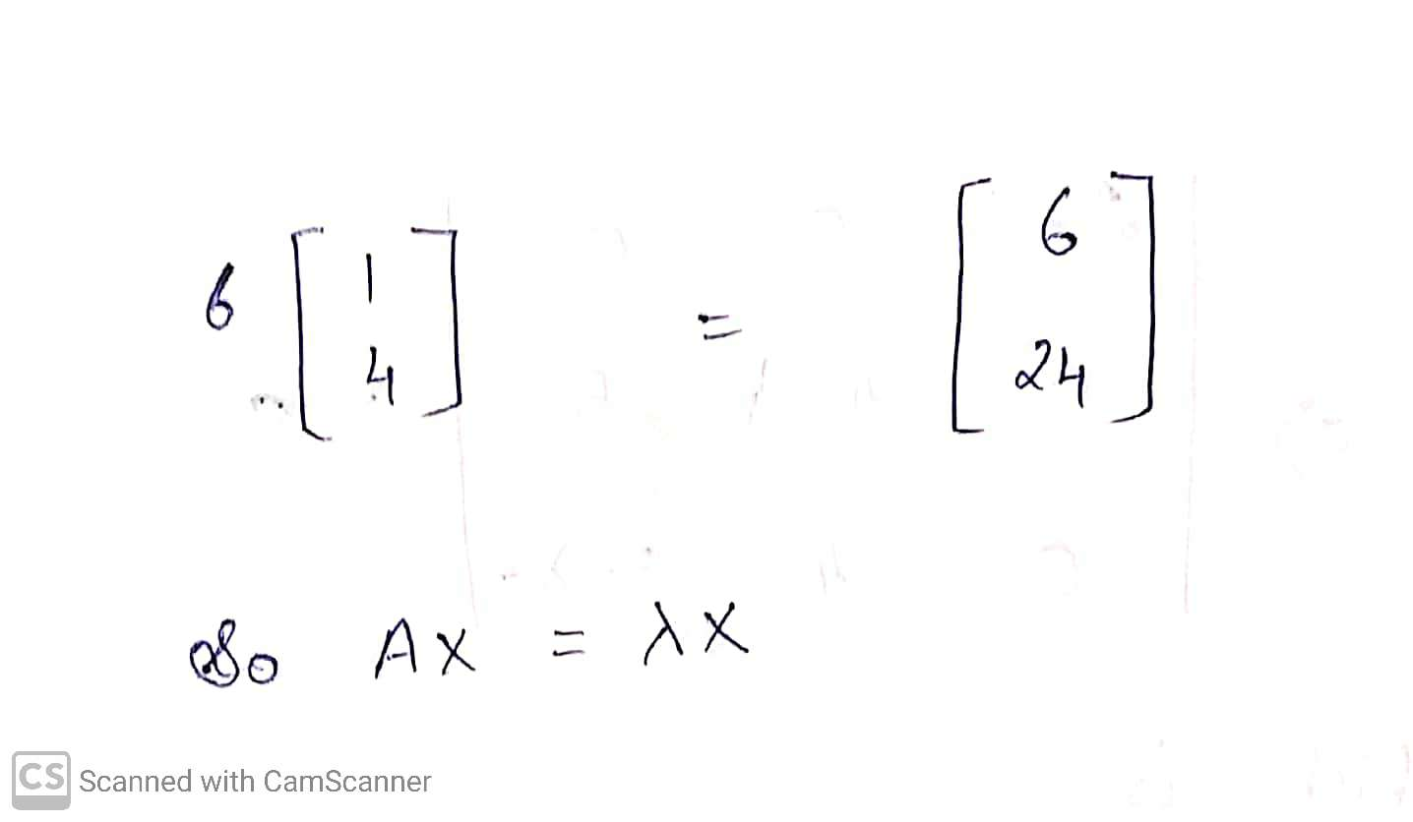
Two Dimensional Matrix
ML LABS PVT LTD || WWW.ANALYTICS6.COM || DATA SCIENCE , AI , ML ,COMPUTER VISION || TRAINING AND CONSULTING
Phone Number : 91-6362546088 || Email : contact@analytics6.com

Slide 12
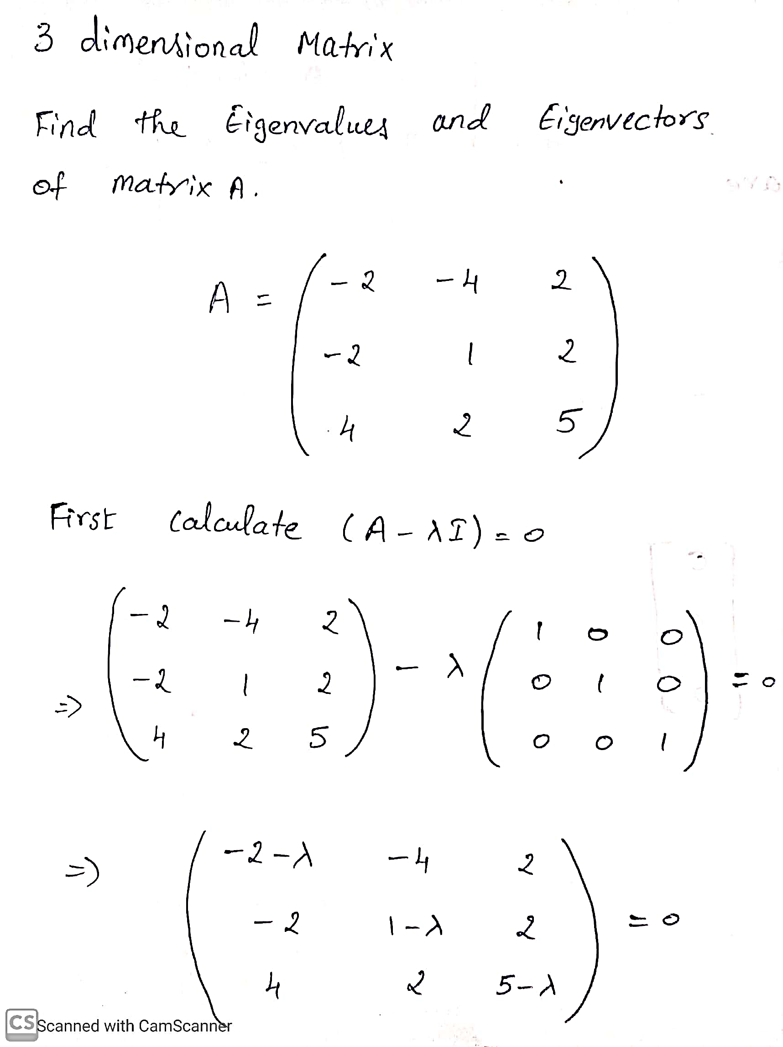
Three Dimensional Matrix
ML LABS PVT LTD || WWW.ANALYTICS6.COM || DATA SCIENCE , AI , ML ,COMPUTER VISION || TRAINING AND CONSULTING
Phone Number : 91-6362546088 || Email : contact@analytics6.com

Slide 13
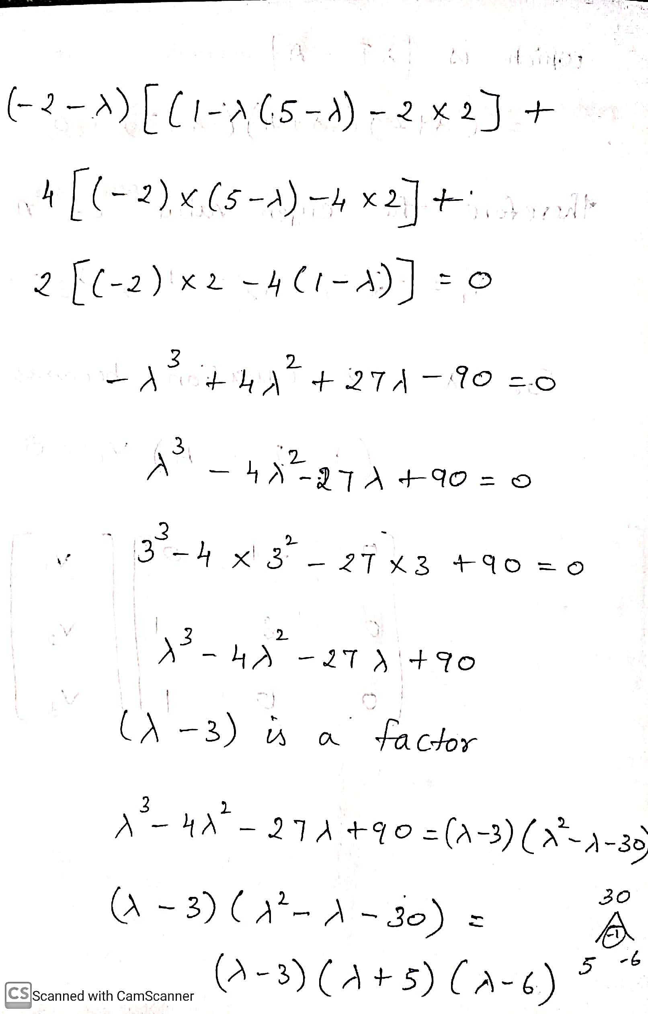
Three Dimensional Matrix
ML LABS PVT LTD || WWW.ANALYTICS6.COM || DATA SCIENCE , AI , ML ,COMPUTER VISION || TRAINING AND CONSULTING
Phone Number : 91-6362546088 || Email : contact@analytics6.com

Slide 14
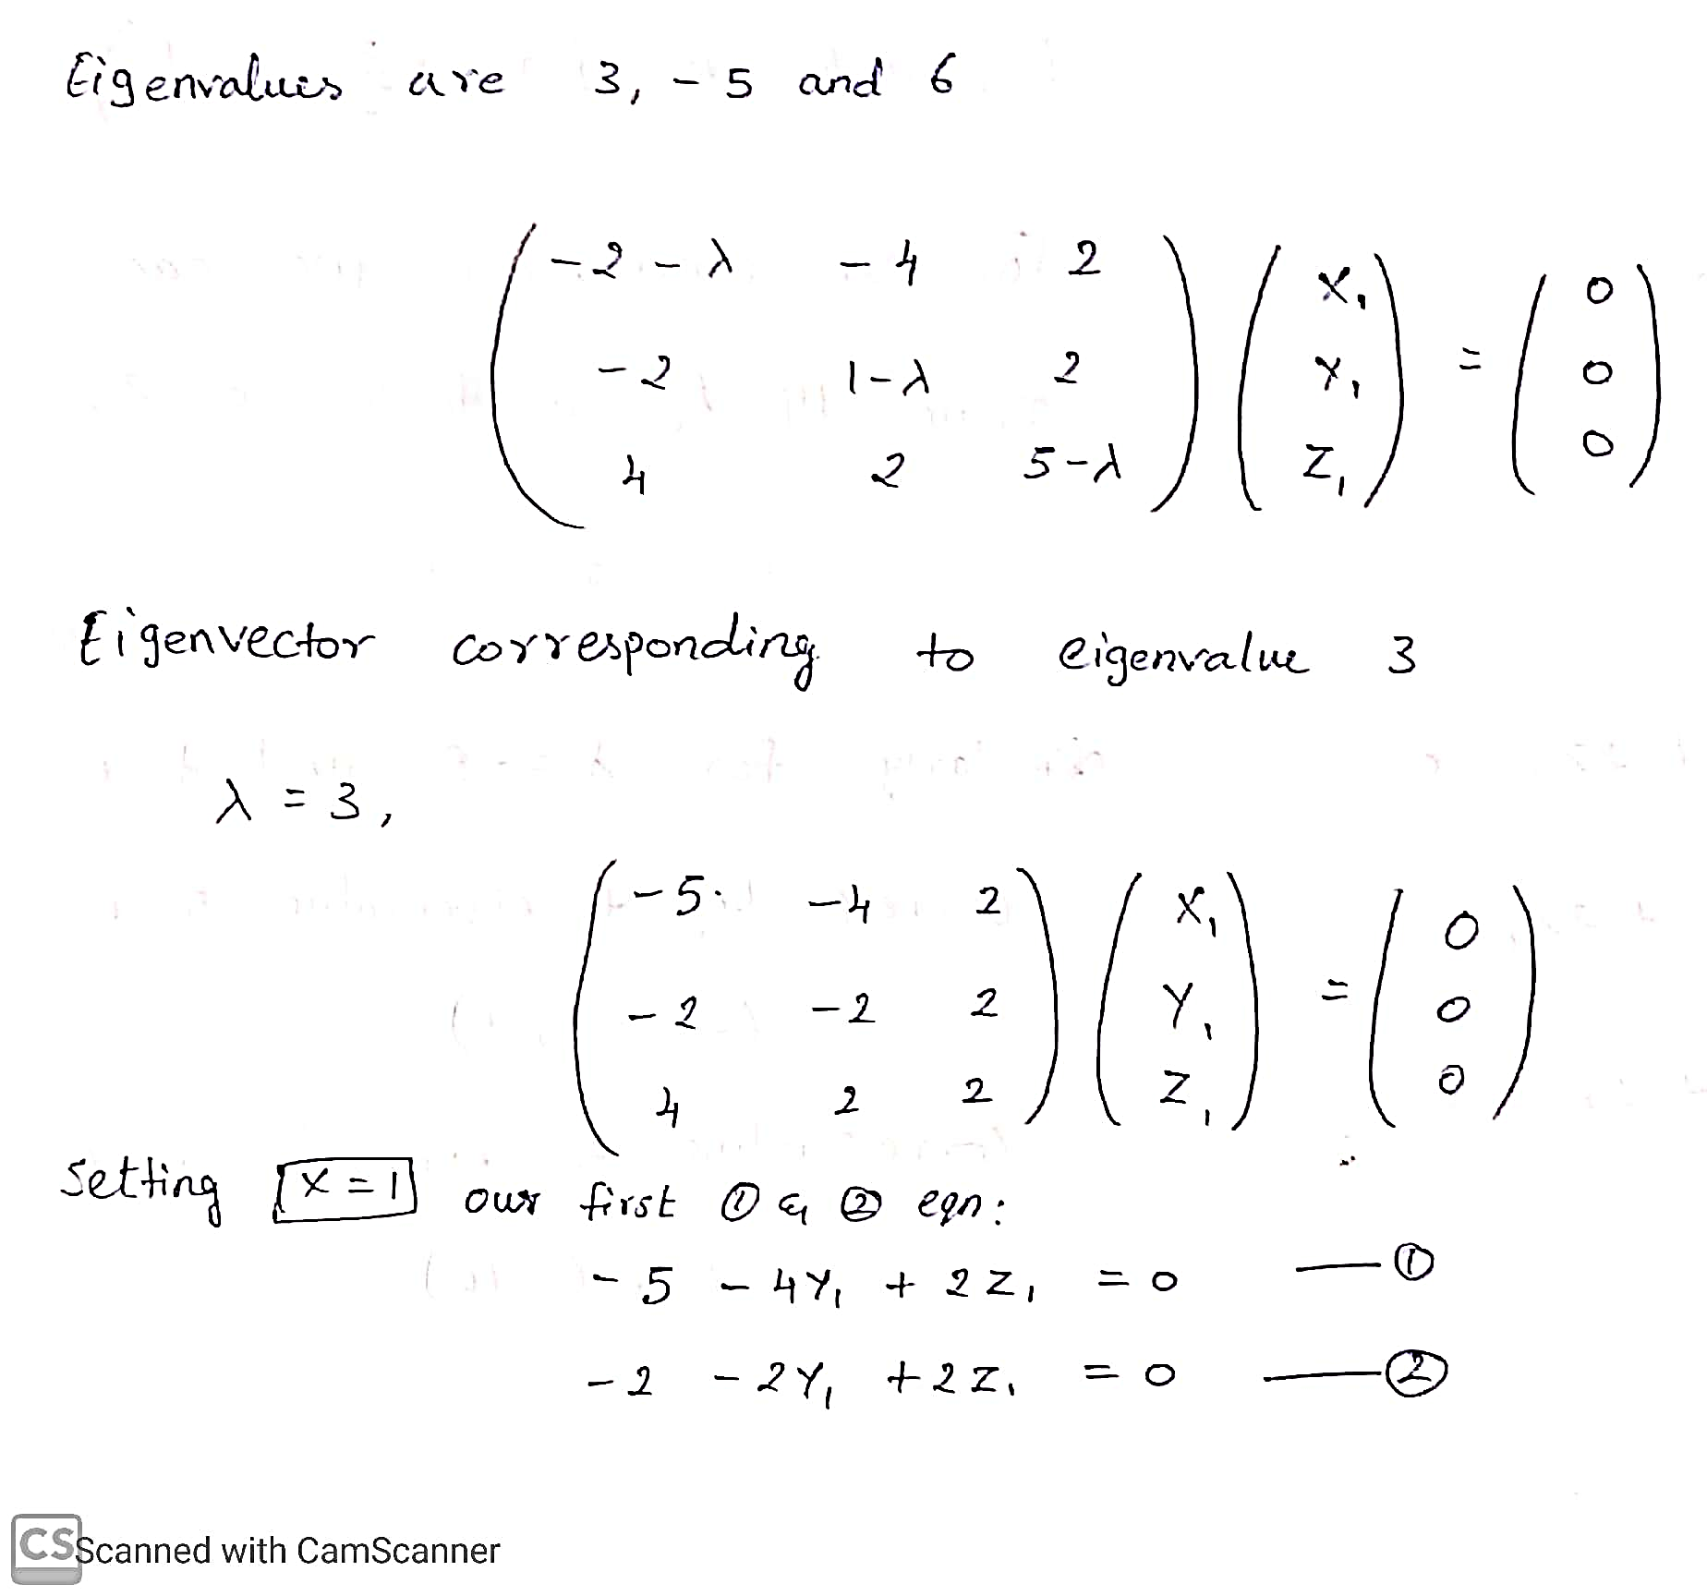
Three Dimensional Matrix
ML LABS PVT LTD || WWW.ANALYTICS6.COM || DATA SCIENCE , AI , ML ,COMPUTER VISION || TRAINING AND CONSULTING
Phone Number : 91-6362546088 || Email : contact@analytics6.com

Slide 15
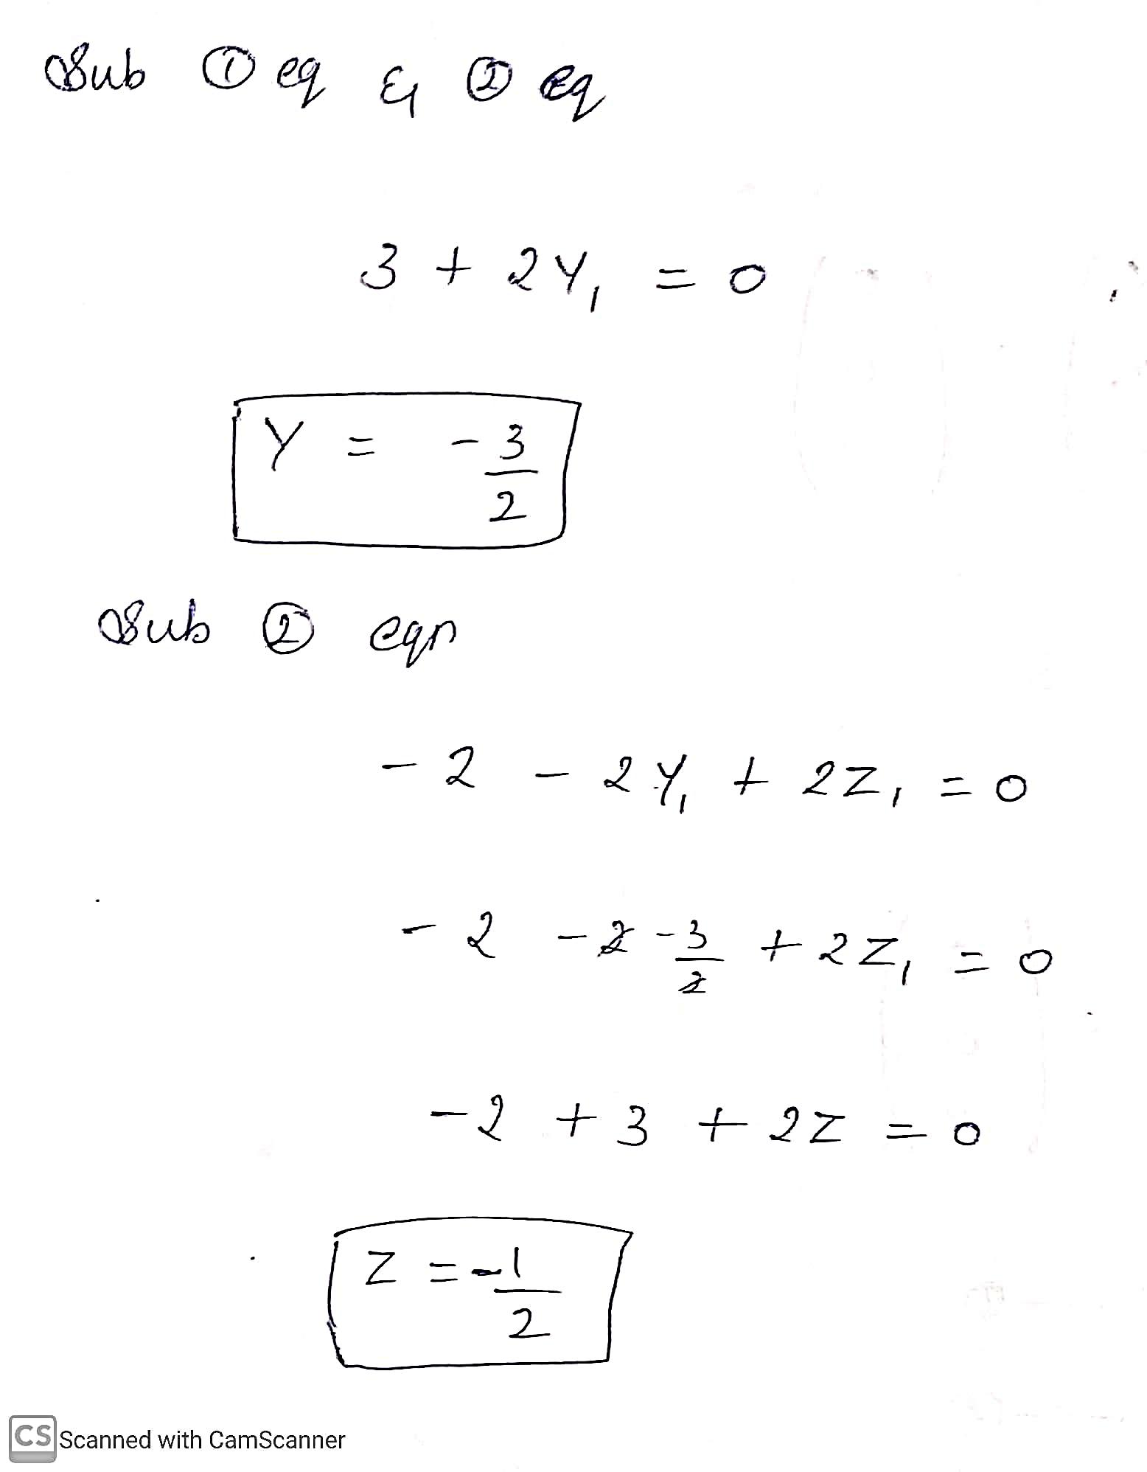
Three Dimensional Matrix
ML LABS PVT LTD || WWW.ANALYTICS6.COM || DATA SCIENCE , AI , ML ,COMPUTER VISION || TRAINING AND CONSULTING
Phone Number : 91-6362546088 || Email : contact@analytics6.com

Slide 16
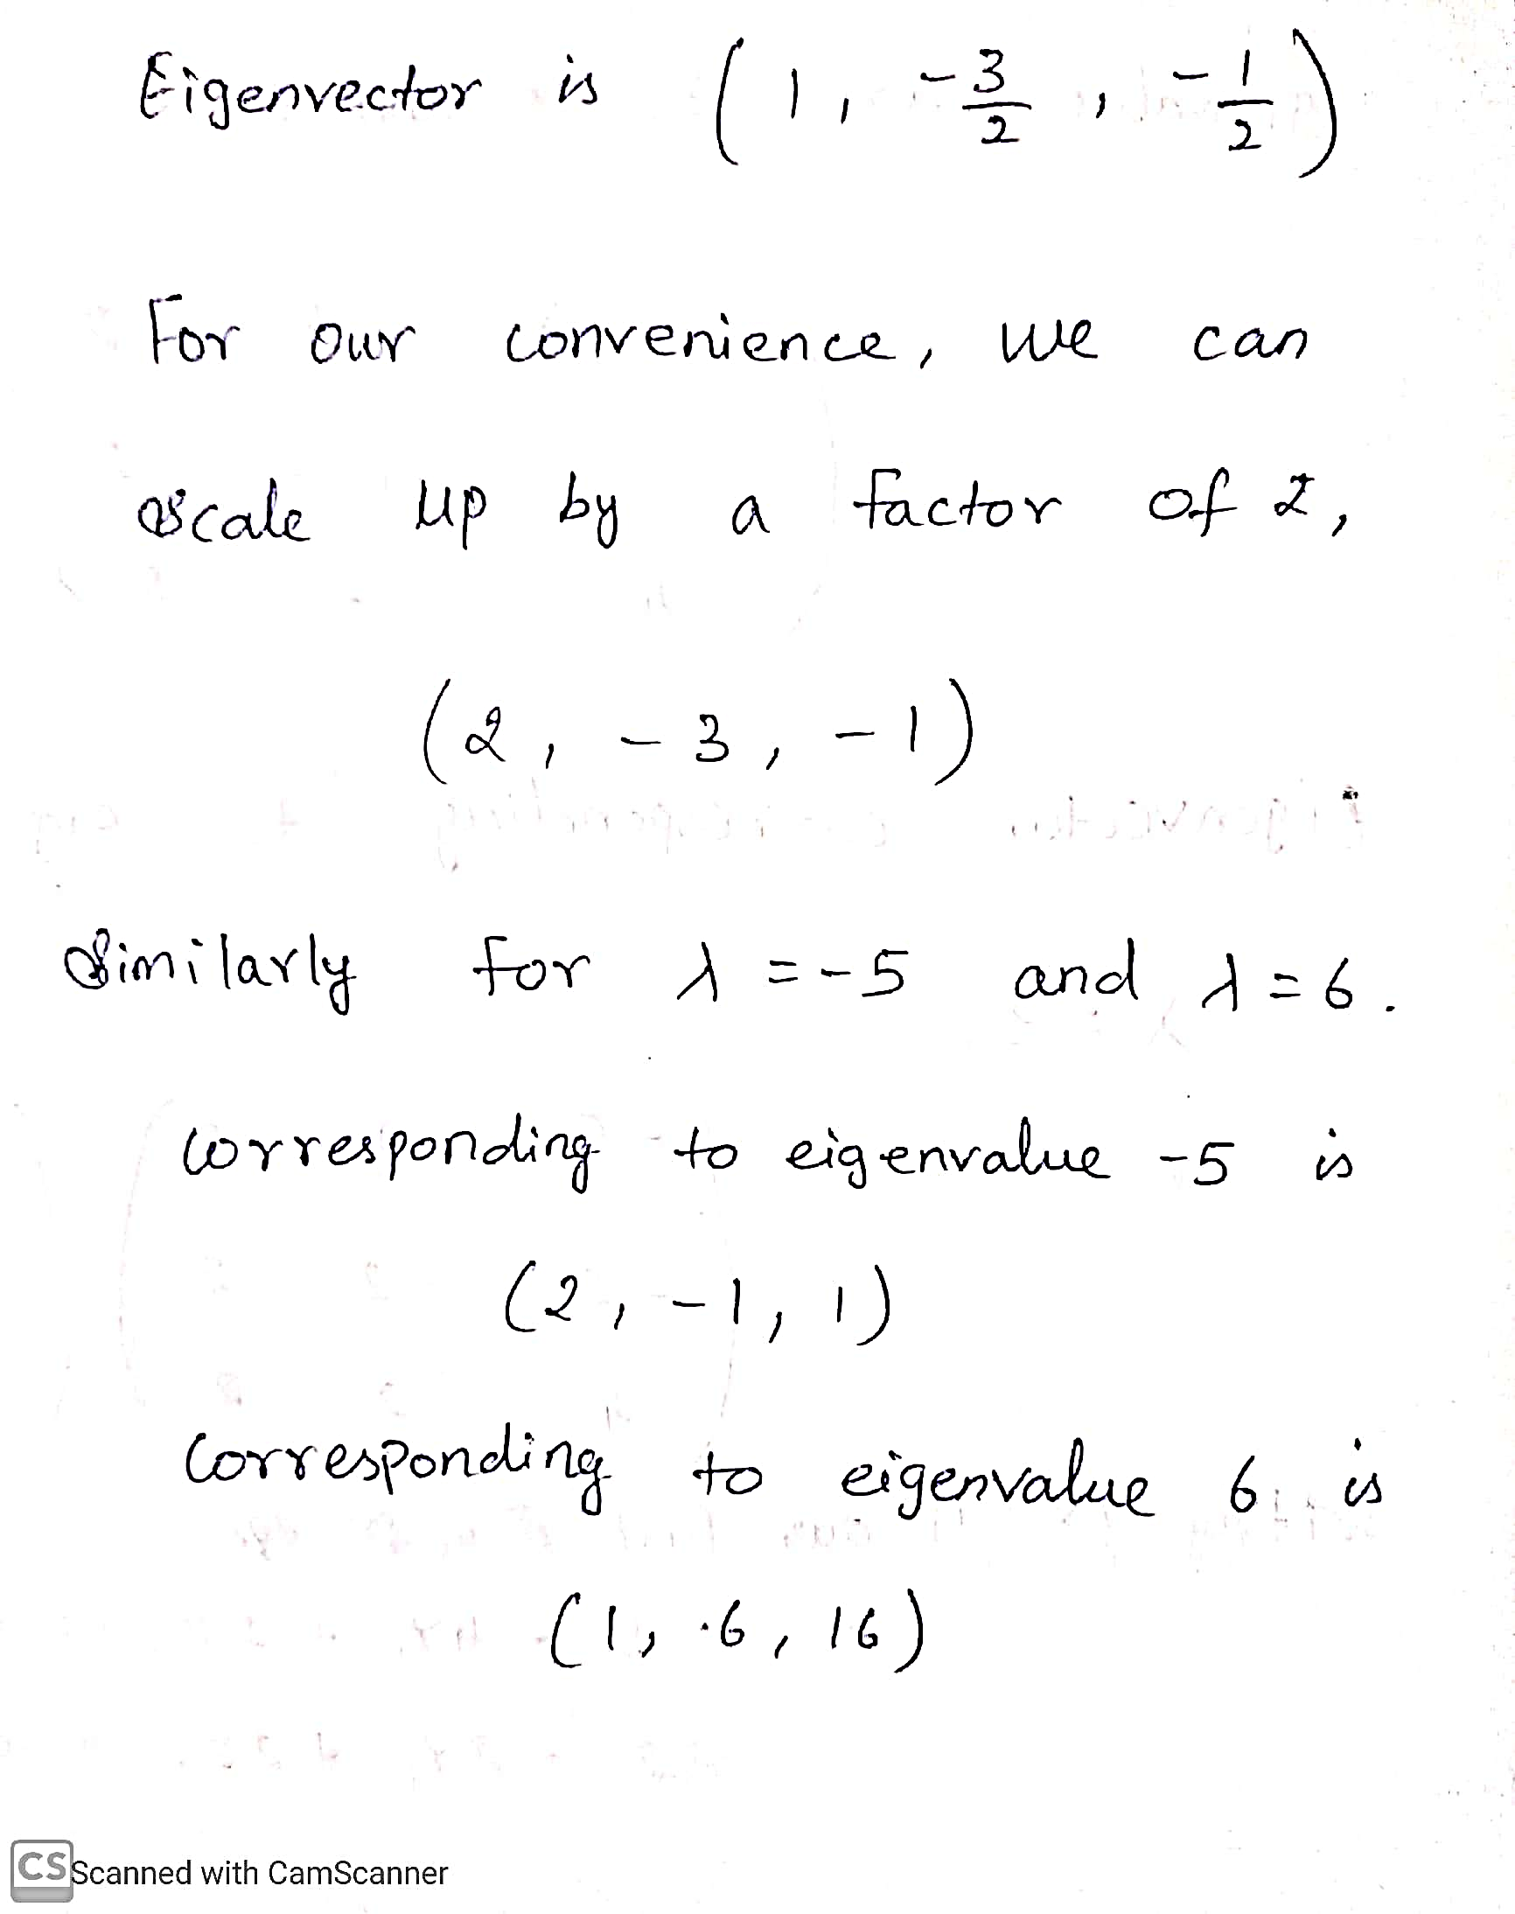
Three Dimensional Matrix
ML LABS PVT LTD || WWW.ANALYTICS6.COM || DATA SCIENCE , AI , ML ,COMPUTER VISION || TRAINING AND CONSULTING
Phone Number : 91-6362546088 || Email : contact@analytics6.com

